Slide 1
Welcome to CN4003
Web Technologies
Dr Fadi Safieddine
Week 1: Introduction to Module and Web Technologies
Dr. Fadi Safieddine Copyright 2021
1

Slide 2

Lecture Content
First part:
Introduction to the module structure.
Importance of the module.
Assessments in the module.
The challenges we shall face.
Module schedule
Guidelines to success.
Review of the Moodle @ UEL.
Announcements

Slide 3
Lecture Content
Second part:
What is the Internet
How does the internet work
History of the Internet
Internet Service Provider (ISP)
Uniform Resource Locator (URL)
Domain Names
IP Addresses
World Wide Web
Web Browsers
Hypertext Transfer Protocol (HTTP)
File Transfer Protocol (FTP)
Anchors
Forms
Session management and cookies
Scripts
Applets & Components
Web animation
Database-driven Web pages.

Slide 4

What’s the module about?
Learning objectives:
Demonstrate an understanding of the key principles in the design and implementation of web pages and the associated technologies, standards and legal requirements.
Elicitate, identify, analyses and specify the requirements for business-oriented projects.
Select appropriate techniques for building websites.
Design and implement a business-oriented web site.
Evaluate, document and present the multimedia website.
Demonstrate evidence of reflection on academic performance by implementing feedback given.
Demonstrate appropriate use of technology to facilitate studies, e.g. use of information resources, production of coursework, communication with tutors and peers.
Notes:
This Photo by Unknown Author is licensed under CC BY-NC-ND

Slide 5

Why is this module so important!!
It assumes little knowledge.
The demand on having Web application development skills is high.
Important skill for your BSc. Project.
Final system is a Tangible outcome.
Notes:
This Photo by Unknown Author is licensed under CC BY-NC-ND

Slide 6
Module Assessment:
The coursework will take the form of a one individual assignment:
Assignment: Finding tools and techniques, analysing requirements, selecting and using tools and techniques to build, evaluate, document and demonstrate a prototype web application. 100%

Slide 7
In the next 12 weeks you will learn:
Lecture 1: Planning a Website and Introduction to the module
Lecture 2: Introduction to HTML 5: Structure, Text, Lists, and Links. (Assignment is out!)
Lecture 3: Introducing CSS, Colour (CSS) & Text (CSS).
Lecture 4: Web modelling and designing & uploading website on a server (FTP), testing and evaluate a website.
Lecture 5:Continuing HTML: Advance HTML,Tables, Form, and layouts.
Lecture 6:Advance HTML 2: forced line, flow text, role-overs, music files and more.

Slide 8
In the next 12 weeks you will learn:
Lecture 7:Advance CSS: Borders, backgrounds, effects, 2D/3D transformations, and animations CSS.
Lecture 8: Basic JavaScript Instructions.
Lecture 9: More JavaScripting: Functions, Methods & Objects, Decision & Loops & DOM.
Lecture 10:Accessibility, compatibility, and web security.
Lecture 11: Maintaining and Promoting a website
Lecture 12: Module review and celebrating best practices.

Slide 9

Guidelines to succeed in this module!
Read ahead:
Review handbook.
Review essential readings – Don’t leave it for last two weeks.
Watch the lectures every week.
Participate in the lecture activities.
Take advantage of the Formative Feedback opportunities.
Write down any questions.
Feel free to ask!
Ask your lab tutor first!!
Email me at fadi@uel.ac.uk
Notes:
This Photo by Unknown Author is licensed under CC BY-ND

Slide 10
Guidelines to succeed in this module!
Be fair to this module in time investment! Give it at least 4 hours reading a week.
Deadlines:
The deadlines are shown in the handbook.
Work as early as possible.
Make use of the formative feedback in the labs.
Give enough time to review it (at least 48hours)!
Make sure you meet the DEADLINE to get the most of your grade!
Be creative.
Notes:
This Photo by Unknown Author is licensed under CC BY-ND

Slide 11
End of Part 1:
Activity 1.1. Identify the best practices to getting the highest grade on this module.

Slide 12
Lecture Content
Part 2
Second part:
What is the Internet
How does the internet work
History of the Internet
Internet Service Provider (ISP)
Uniform Resource Locator (URL)
Domain Names
IP Addresses
World Wide Web
Web Browsers
Hypertext Transfer Protocol (HTTP)
File Transfer Protocol (FTP)
Anchors
Forms
Session management and cookies
Scripts
Applets & Components
Web animation
Database-driven Web pages.

Slide 13

What is the Internet?
The Internet is a worldwide collection of networks that supports personal and commercial communications exchange.
The Internet has redefined how we think about computers, communications, and commerce in many ways.

Slide 14
A Brief History:
It began in 1969 as an experiment by the U.S Defense to develop a network that could withstand a cold war outages.
At the start it was called the ARPANET.
As it grew hundreds of colleges and universities tapped into ARPANET for research sharing.
In the late 1980s, ARPANET was renamed the Internet.
The Internet went virtually unnoticed by the general public and business community for over two decades.
In 1989, Tim Berners-Lee, working at a laboratory called CERN in Europe, proposed the idea of the World Wide Web, and the Internet was an overnight success.

Slide 15
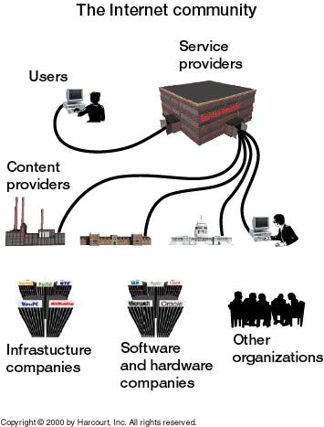
Who Makes up the Internet
Users
Service Providers
Content Providers
Infrastructure Companies
Software & Hardware Companies
Governments
Internet Society
Colleges & Universities

Slide 16

What is the Internet used for?
Fast World Wide Communication Medium (Email, Skype, Social Networks, Apps, IoT)
Research – the source of vast amounts of information
Downloading and Uploading software
News and information
E-commerce (Selling and Buying over the net)
Listening to live and recorded radio ,TV, and films originating from anywhere in the world.
Can you think of anything else?

Slide 17

How the internet work?
An International Computer Networks
Very powerful computers:
known as hosts or Internet Servers.
Need to be monitored 24 hours a day
Allows communication between computers via fast communication channels
Examples of communications media:
copper or fibre-optic cables
microwaves via satellite
point-point microwaves or radiowaves

Slide 18
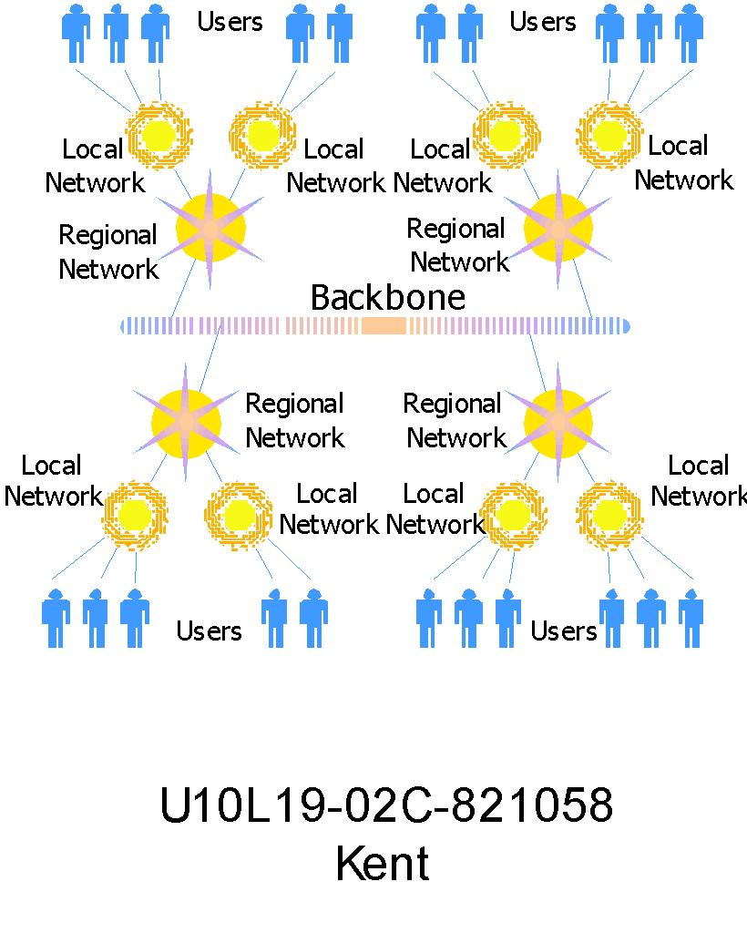
Notes:
Reference: http://newtecharticles.com/from-where-internet-comes-how-internet-works/ Last Accessed 11/06/2013

Slide 19

Internet Vs Web:
The Internet is the physical connection of millions of networks.
The Web uses the Internet for its existence.
The Web consists of hypertext embedded on Web pages that are hosted on Web sites.

Slide 20
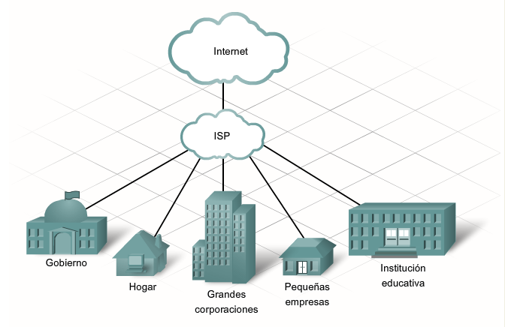
Internet Service Provider (ISP)
Provides local access to the Internet backbone
You need this to connect to the internet.
Ps: You pay a fee for this service.
Example: BT, Sky, Virgin,…etc
This Photo by Unknown Author is licensed under CC BY-SA

Slide 21
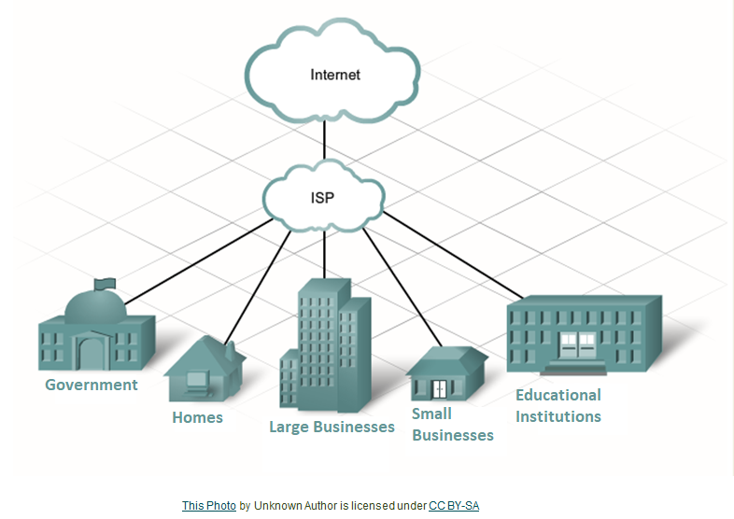
Internet Service Provider (ISP)

Slide 22
End of part 2
Activity 1.2. What do you use the Web for?
Social Media (Socialising)
News
Watching Videos, TV, and Movies
Listening to Podcast and Radio
Playing
Studying
Buying
Selling

Slide 23
Important terms:
Part 3
Hypertext is a way of presenting information so that the order in which it’s read is left up to the reader.
Hyperlinks are underlined or highlighted words that can be used to view another document or Web page.
Hypermedia refers to a link to multimedia, such as music and movies.
The Web is a distributed hypermedia system or a system where the responsibility for creating content is distributed among many people.

Slide 24
Uniform Resource Locator (URL)
Web addresses are an addressing system that identifies where a Web resource is located.
The uniform resource locator (URL) is the standard used to identify Web resources.
The URL consists of:
Protocol identifies the means of access
Server contains the domain name of the Web server
Path identifies the location of the document
Resource specifies the filename of the resource
URL
http://
www.yahoo.com/
help/
shop/
shop-01.html

Slide 25
DNS - Domains and Subdomains
Most Internet hosts or servers have a Domain Name System (DNS) address, which uses words.
A domain name identifies the type of institution that owns the computer. An Internet server owned by BT might have the domain name bt.com.
Some enterprises have multiple servers, and identify them with subdomains, such as products.bt.com.

Slide 26
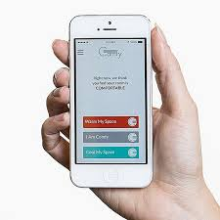
Internet Protocols
Internet Protocols stands for the rules of communications.
For different set of communication we would have different rules to govern the communications.
This reduces problems when to computers are communicating with each other.
We will learn here about four important ones: HTTP, TCP, IP and FTP.

Slide 27
HyperText Transfer Protocol (HTTP)
HTTP stands for HyperText Transfer Protocol
This protocol defines the steps necessary for computers to communicate over the World-Wide Web.
HTTP is basic and simple however its functionality is vital technology in the E-commerce communication.
Static HTTP: two types
Original HTTP: http://www.fadi.me.uk
Secured HTTPS: https://ibank.barclays.co.uk (encrypted)
Dynamic HTTP: two types
GET HTTP: http://ipcis.com/database/search.asp?query=userquery
POST HTTP, helps to send information over the internet (cannot be view for security reason!)

Slide 28
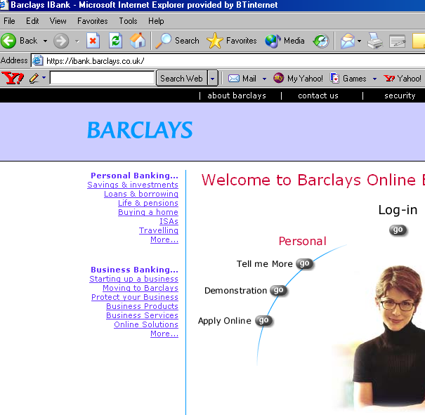
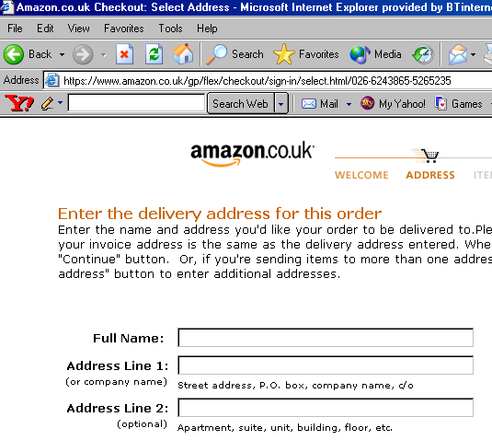
HyperText Transfer Protocol (HTTP)
So how do you know a Website is secured?
https: means that all communications are encrypted.
https: is a mathematical certificate issued only to registered companies with good credit reference.
This makes the connections slower because every communication is sent as secret communication.
You should NEVER trust putting your credit card or login to bank account if you do not see the https in the address.

Slide 29
Internet Protocols (TCP and IP)
Transmission control protocol (TCP) – A standard that defines how one computer can communicate and exchange data with another computer on the Internet.
Internet protocol (IP) – Defines the Internet’s addressing scheme.
IP address – Each computer connected to the Internet is given an address composed of numbers and periods. Example: 209.234.456.8

Slide 30
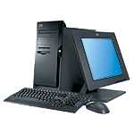
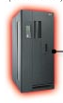
File Transfer Protocol (FTP)
Your Computer
FTP Server
DOWNLOAD
UPLOAD
FTP is a part of the Internet that enables client computers to transfer files.
Transferring files from an FTP site to the client is known as downloading.
Transferring files from the client to an FTP site is known as uploading.
Clients may store files on an FTP site’s server.

Slide 31
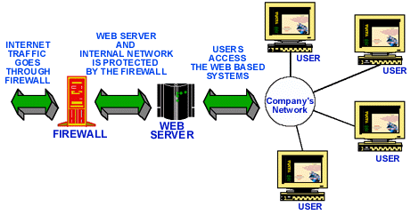
Intranets and Extranets
Intranet – An internal networking system within a company
They function like the Internet
They are for internal use only and are not available to those outside the company
Companies
Some Countries
Firewall – Software used to screen incoming data
Extranet – An intranet that can be used by outside sources who access it over the Internet

Slide 32
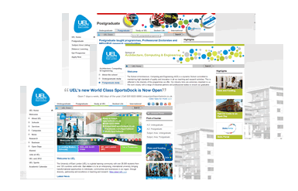
Internet Browsers:
Software application that finds hypertext documents on the Web and opens them on the user’s computer.
Essential for converting web pages into something visual that users can understand
Early browsers:
unable to take advantage of graphics formats
only displayed text and hyperlinks
Recent browsers:
Allow graphics and movies plug ins

Slide 33
End of Part 3
Activity 1.3. Identify the correct definitions for the following terms:
Hypertext
Hyperlink
Hypermedia
Internet Browser
Intranet
Extranet
URL
HTTP
HTTPS
FTP

Slide 34
Static Vs Dynamic pages
Part 4
Static Website: These are static pages with no interaction with user.
They are like pages of a book, you can just read the Website and move from one page to the other.
Dynamic Web applications: These are fully interactive Web sites that allow users to interact with program on several levels.
These are pages that allow users to make commercial order, it can store your details for future visits, and/or allow you to send/receive messages.

Slide 35
Static Vs Dynamic pages
Examples of Static Web pages:
Some: Home pages, Newspaper pages, and some small businesses.
Examples of Dynamic Web pages:
- All: Web emails, E-commerce companies, Web pages involving login…etc.

Slide 36
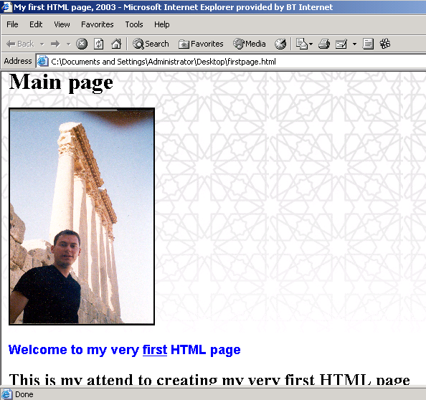
Example of Static page

Slide 37
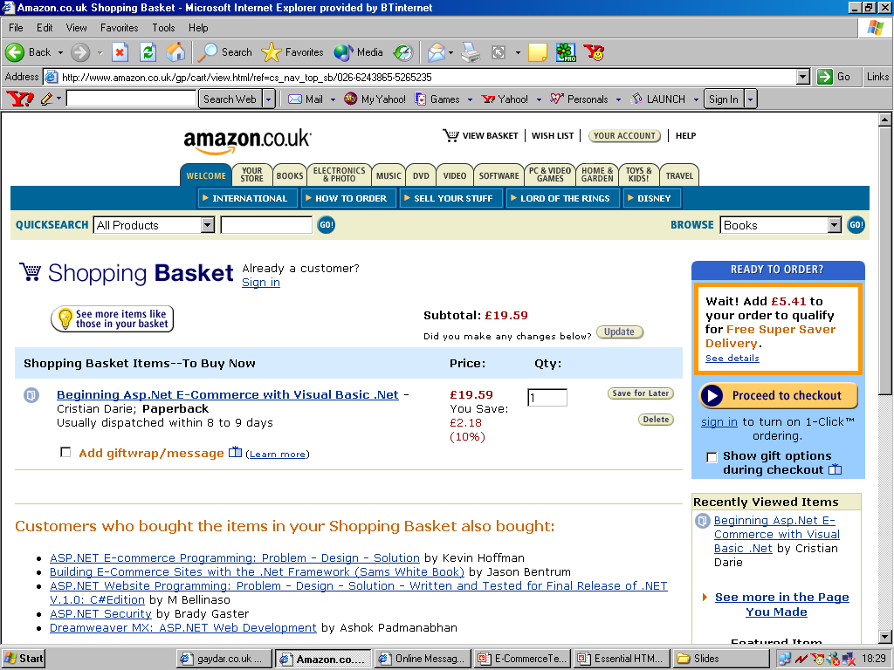
Example of Dynamic page

Slide 38




Static vs Dynamic
Technically the difference is:
Static Web Page:
Dynamic Web page:
Web
Browser
Client Computer
Render
Client Computer
Display
Request
Request
HTML file
HTML page
PHP page
Render
Database repository
Web Server
Web Server

Slide 39
Static vs Dynamic
Technically the difference is:
Static pages store all the information on that page
This makes it difficult to update.
You can only update it by re-writing and publishing the page online.
Whereas dynamic pages stores all the information in a database.
Makes it much easier to update.
You update it but login into the system and updating the information.
This information is stored into the database and is ‘automatically’ viewed by Web users.

Slide 40
Static vs Dynamic:
So how do we program these pages:
Static Web programming languages:
Hypertext Markup Language (HTML)
Packages:
Note pad++
MS Word and save it as HTML
Dreamweaver packages and save as HTML
And many other packages
Dynamic Web programming languages:
Active Server Program (ASP)
Hypertext Preprocessor. (PHP)
Java Server Pages (JSP).
Extensible Markup Language (XML)

Slide 41
End of Part 4
Activity 1.4. What is the key difference between static and dynamic website?
Design
Layout
Coding
Use of a database
Security measures

Slide 42
Anchors
Part 5
An anchor is a hyperlink to another web page, it is the means by which users can navigate a Web site.
Three types of anchors:
Normal link from one page to the other.
Link to a specific section on a page.
Containing parameters to be executed by that database (www.ipcis.com/Database/St_Log.asp?Login=guest&Password=IPCIS )

Slide 43
Forms
An HTML Form is part of a Web page that can accept users’ input.
This feature usually `distinguishes a static Web site from a dynamic Web application.
Forms are used for:
Feedback collection
Searching databases
Submitting details
& Making E-commerce orders

Slide 44
Forms
Stages of communication between form an server.
Forms:
Server
Submit form
Web page
Form
New page
Database
& Online Objects
Executable page

Slide 45
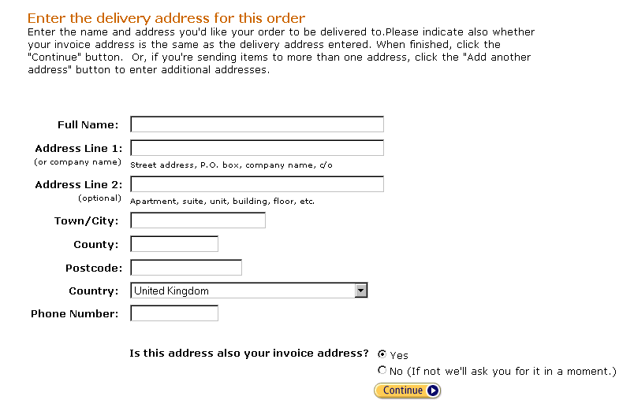
Forms
Elements you can get on a form:
Text boxes
Buttons
Drop lists
Select lists
Check boxes
Radio boxes
& Field boxes

Slide 46

Cookies and Session management
Cookies are short string of characters storied in a file that is send by a scripted page.
Cookies enables Web servers to distinguish between different clients.
It can help Web applications to custom Web pages and functionality on a client-by-client basis
Notes:
This Photo by Unknown Author is licensed under CC BY-NC-ND

Slide 47
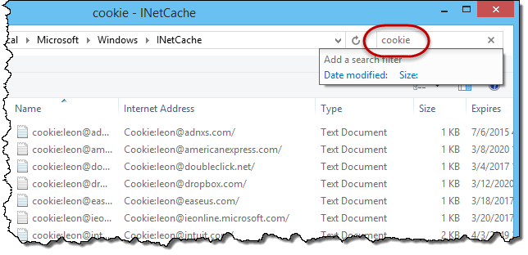
Cookies and Session management
How do cookies work:
Customer registers at a website.
The website leaves a small file in the customer’s computer.
This file is accessed whenever the customer visits that website again.
Each cookie has an expiry day, if you don’t access that website for so much time, the cookie is deleted automatically by the browser.
Notes:
This Photo by Unknown Author is licensed under CC BY-NC-ND

Slide 48
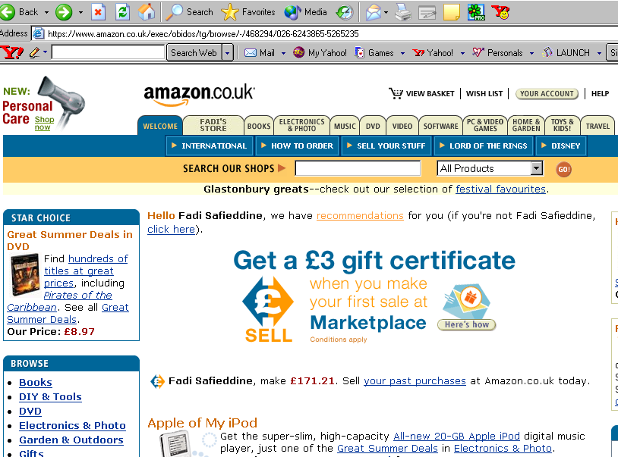
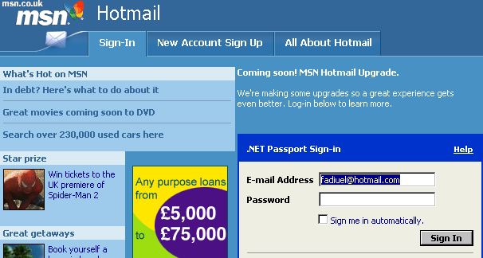
Cookies and Session management
Importance of cookies:
Customise the views for customers.
Keep track of customers orders.
& Improves security through session management, such as when a session expires.

Slide 49
Scripts (Java Scripts Vs Visual Basic Scripts)
A script is a small piece of program that is inside the web page or sent as a separate file
A script is interpreted by its respective ‘interpreter’ in the order it appears in an HTML page.
We have two types of scripts:
Client Side Scripts (attached to the page)
Server Side Scripts (stay on the server)

Slide 50
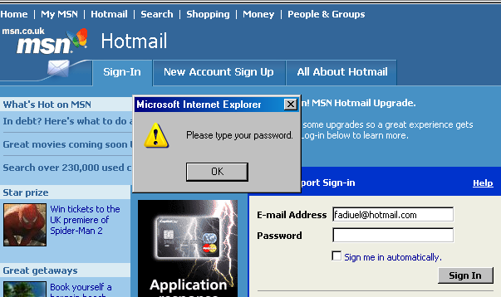
Scripts
Server-side scripts are usually used to:
Connect a page to a database.
To perform calculations
Client-side scripts are usually used to:
Enhance presentation (interface)
Validate inputs in the interface.
Java Scripts Vs Visual Basic Scripts:
They virtually present the same features!

Slide 51
Applets and Components
An Applets is a self-contained application or code fragment, with aim to perform a specific function.
You can buy these applets off-shelves and add the code to your website.
Examples:
Adding a forum / chat room to your website.
Online games

Slide 52
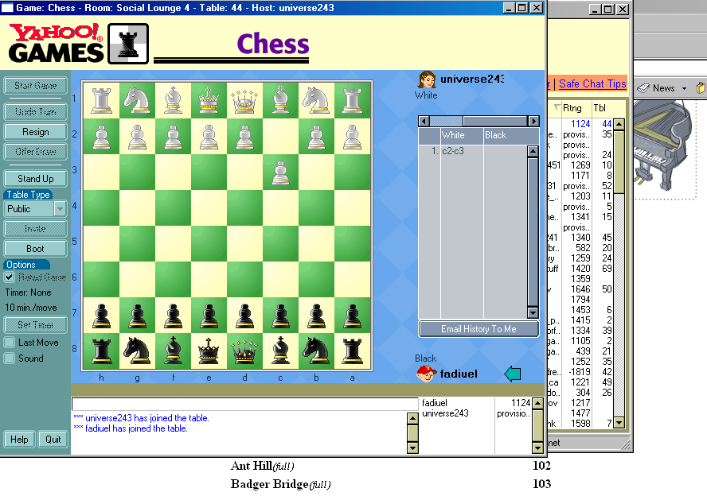
Applets and Components

Slide 53

Web Animation
There are people who are with and against using Web animations.
Those supporting it:
It is good design
It is can enhance interface.
An animation is better than thousand pictures!
Those against it:
Distractive
Only interesting the first time!

Slide 54
Web Animation
Types of animations:
Image animation.
Button animation.
Whole page animation.
Example:
Adobe Flash (animation)
Adobe Fireworks (graphics)

Slide 55
End of Part 5
Activity 1.5. Identify the meaning of the following Web Technologies:
Anchors
Forms
Cookies
Session management
Scripts
Applets
Web Animation

Slide 56
Supervised Practical
Part 6
Please attend your lab practice.
You will get introduced to your tutors.
Get started with class practice.
Why you should complete all your practice?

Slide 57
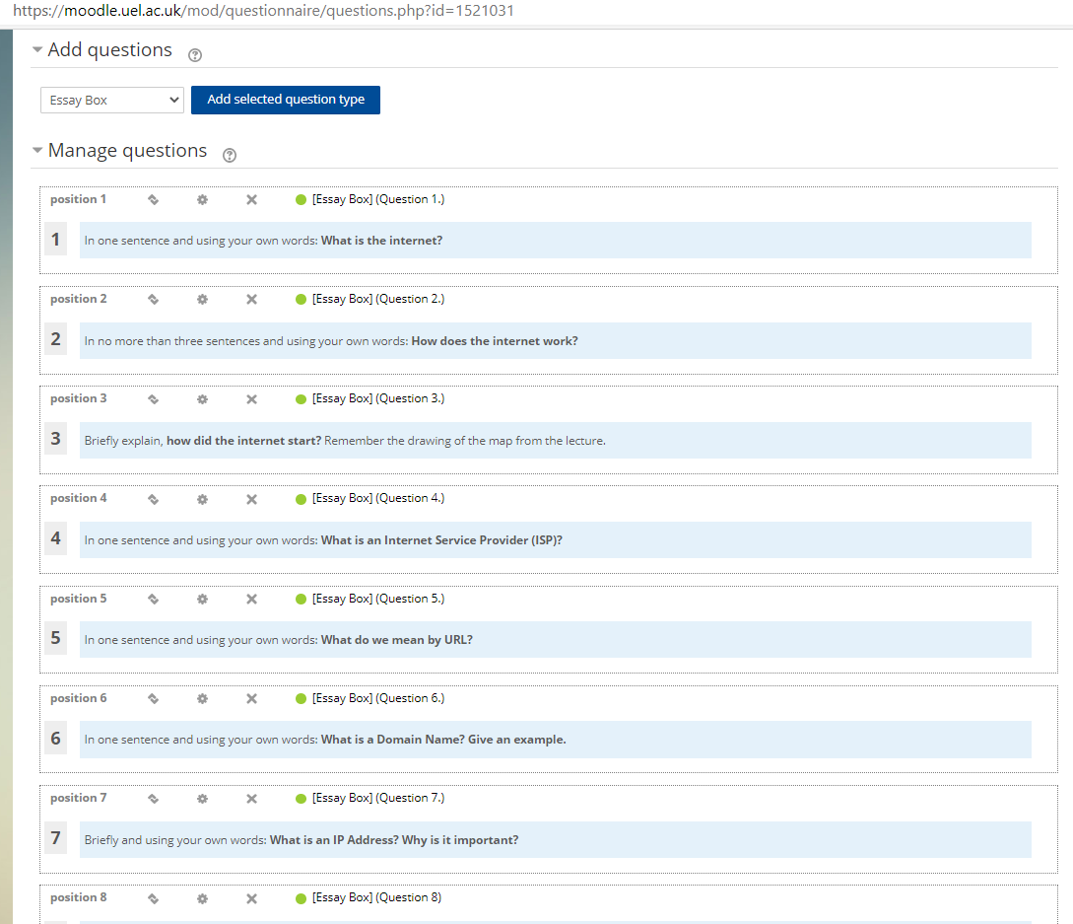
Demo of the class practice

Slide 58
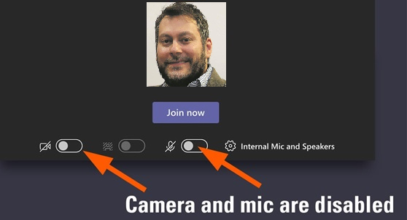
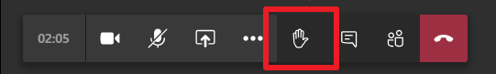
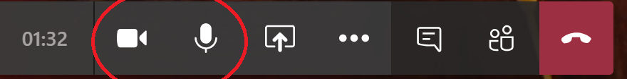
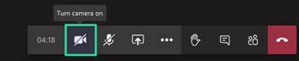
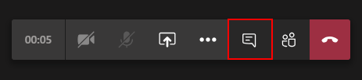
Etiquette for students during live sessions:
By default:
1. Please add a profile photo, it helps everyone relate to you.
2. Keep your camera and microphone disables.
If you have a question:
1- Raise your hand.
2- When acknowledged, unmute the microphone and enable the camera (optional).
3- When you finish, remember to ‘lower’ your hand, disable the camera and mute the mic.
4- Otherwise, feel free to write in chat box. Remember that everyone can read what you write in the chat box.
Alternatively, you can email me and I will reply after the session.

Slide 59

Next lecture:
Introduction to HTML
Defining HTML
Creating HTML page
Creating title.
Create paragraphs and texts.
Creating hyper links
Inserting background
Inserting images and changing attributes
Changing text attributes.
Color
Type
size

